Slide 1

Title slide + image
Midterm Report
Tianchen Qu

Slide 2


Slide 3
More intuitive heuristics
More approachable poster

Slide 4
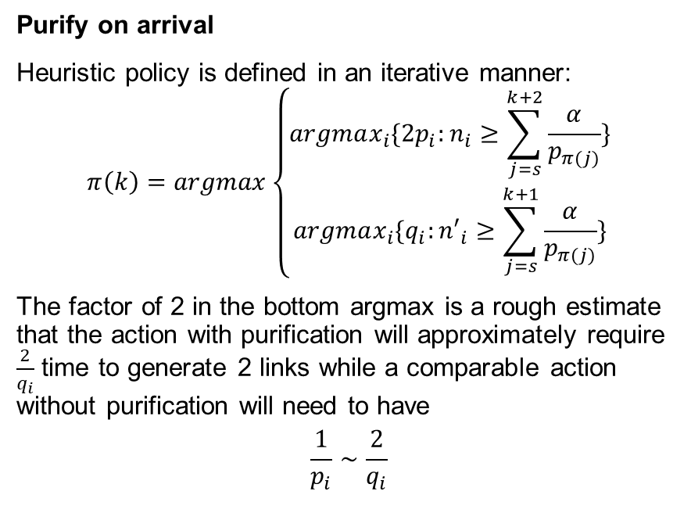
EPL scheme
Given two R-states
Both Alice and Bob adopt a CNOT gate on their local qubits
Both Alice and Bob measure the target qubit.
Alice and Bob communicate over the channel and only accept and return the controlled qubits when the measurement gives ‘11’
BBPSSW scheme
Given two qubit with depolarized noise
Both Alice and Bob adopt a CNOT gate on their local qubits
Both Alice and Bob measure the target qubit.
Alice and Bob communicate over the channel and only accept and return the controlled qubits when the measurement gives ‘11’ or ‘00’
Purify on arrival
Heuristic policy is defined in an iterative manner:
$$π\left(k\right)=argmax\left\{\begin{aligned}argmax_{i}\{{2p}_{i}:n_{i}≥\sum_{j=s}^{k+2}{\frac{α}{p_{π(j)}}}\} \\ argmax_{i}\{q_{i}:{n′}_{i}≥\sum_{j=s}^{k+1}{\frac{α}{p_{π(j)}}}\}\end{aligned}\right.$$
The factor of 2 in the bottom argmax is a rough estimate that the action with purification will approximately require $\frac{2}{q_{i}}$ time to generate 2 links while a comparable action without purification will need to have
$$\frac{1}{p_{i}}∼\frac{2}{q_{i}}$$
24-5-2024

Slide 5
Weekly Progress
 | Week 1 | Week 2 | Week3 | Week 4 | Week 5
Research plan
Look-ahead heuristic
Interpolation attempt
Adding purifications
Other possible heuristics
Midterm poster/report |  |  |  |  | Right Now:D

Slide 6
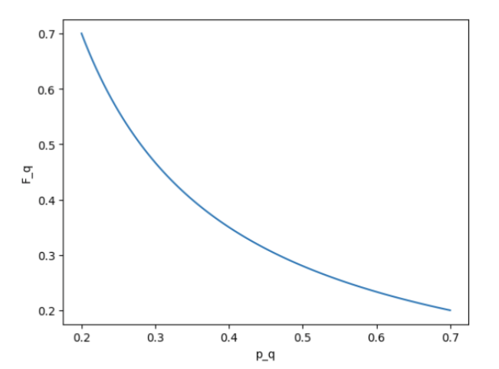
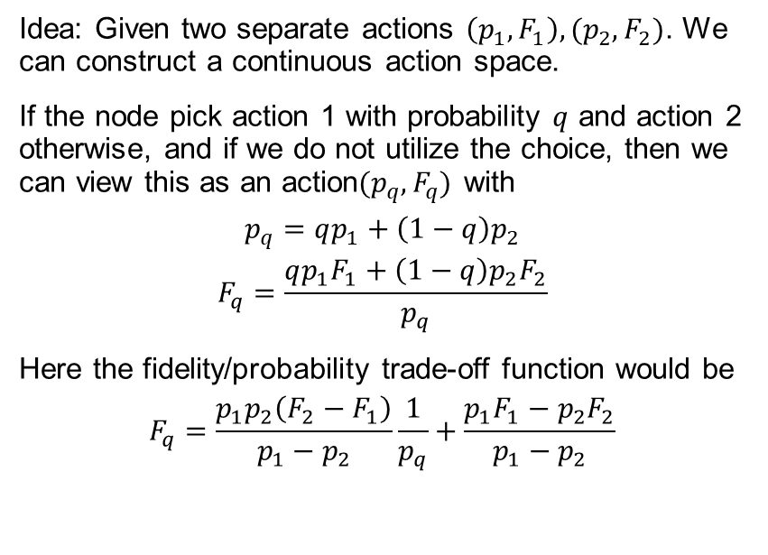
Interpolation
Idea: Given two separate actions $\left(p_{1},F_{1}\right),(p_{2},F_{2})$. We can construct a continuous action space.
If the node pick action 1 with probability $q$ and action 2 otherwise, and if we do not utilize the choice, then we can view this as an action$(p_{q},F_{q})$ with
$$p_{q}=qp_{1}+\left(1−q\right)p_{2}$$
$$F_{q}=\frac{qp_{1}F_{1}+\left(1−q\right)p_{2}F_{2}}{p_{q}}$$
Here the fidelity/probability trade-off function would be
$$F_{q}=\frac{p_{1}p_{2}\left(F_{2}−F_{1}\right)}{p_{1}−p_{2}}\frac{1}{p_{q}}+\frac{p_{1}F_{1}−p_{2}F_{2}}{p_{1}−p_{2}}$$
Problem with interpolation:
It is strictly worse than linear trade-off action, thus it will only be useful when continuous native action space is hard to achieve.

Slide 7
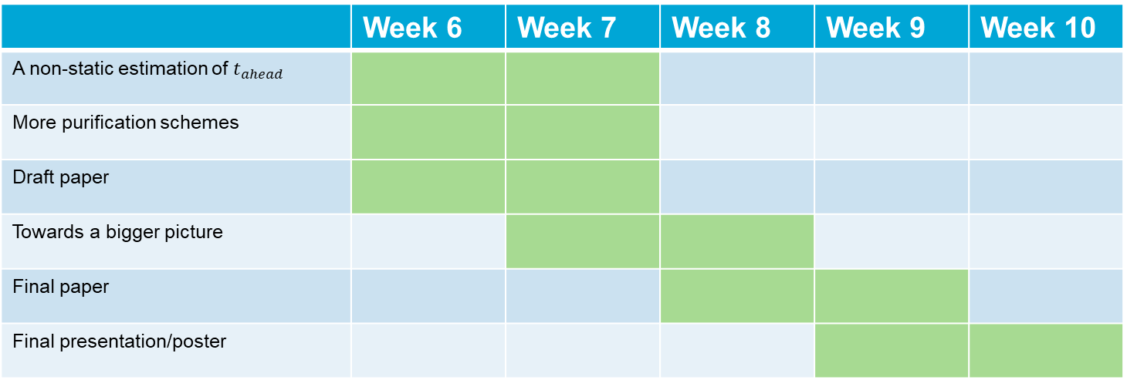
Future plans
 | Week 6 | Week 7 | Week 8 | Week 9 | Week 10
A non-static estimation of $t_{ahead}$
More purification schemes
Draft paper
Towards a bigger picture
Final paper
Final presentation/poster

Slide 8
Title slide + image
Thank You!
Tianchen Qu

